Slide 1
Dr. Sunirmal Khatua
Introduction to Distributed Computing
By
Visvesvaraya Young Faculty Fellow, Govt. of India
Assistant Professor, University of Calcutta
Notes:
We celebrate Christmas to remember the birth of Jesus Christ

Slide 2
Lesion Plan
1. Distributed Computing Platforms - 3 Lectures
2. Introduction to Cloud Computing - 1 Lecture
3. Virtualization Technologies - 2 Lectures
4. Programming on Cloud Platforms (AWS, GCP, Azure) - 3 Lectures
5. Microservices and Container - 1 Lectures
6. Introduction to BigData and MapReduce - 2 Lectures
7. Cloud Security - 1 Lectures
8. Research topics on Cloud - 2 Lectures

Slide 3
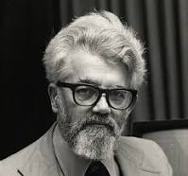
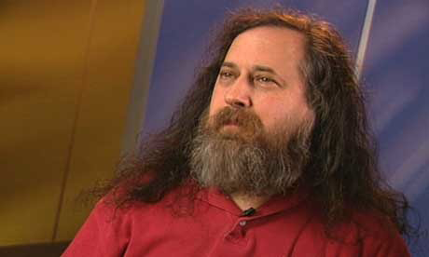

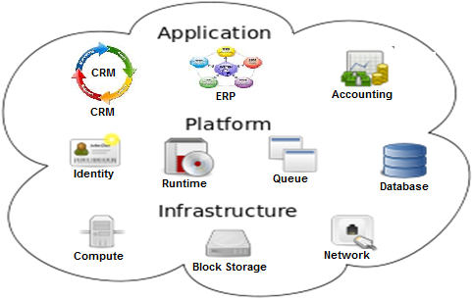




What is a Cloud Computing?
“Computation may someday be organized as public utility.”
“Cloud Computing is stupidity. It's worse than stupidity: it's a marketing hype campaign.”
-- John McCarthy, Cognitive Scientist, 1961
-- Richard Stallman, GNU Founder, 2008
The term Cloud is a metaphor for Internet

Slide 4
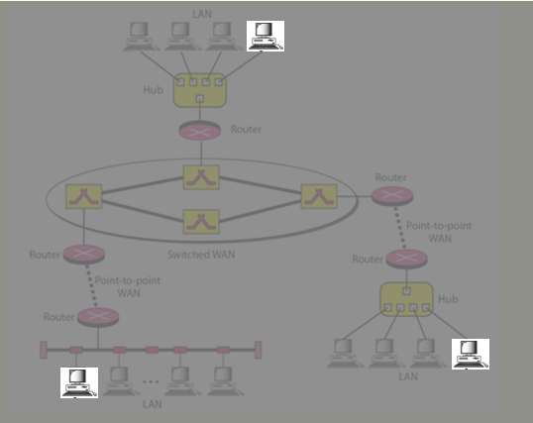
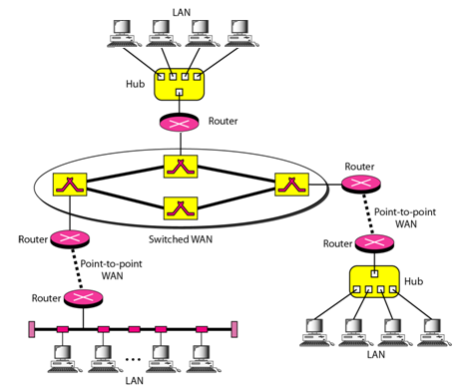

What is a Distributed Computing Platform?
A Distributed System is a Collection of SMALL independent computers that appears to its users as a single BIG coherent system.
Properties of Distributed Algorithm:
Multiple Processes
Interprocess Communication
Disjoint Address Spaces
Collective Goal
The Gulliver’s Travel

Slide 5
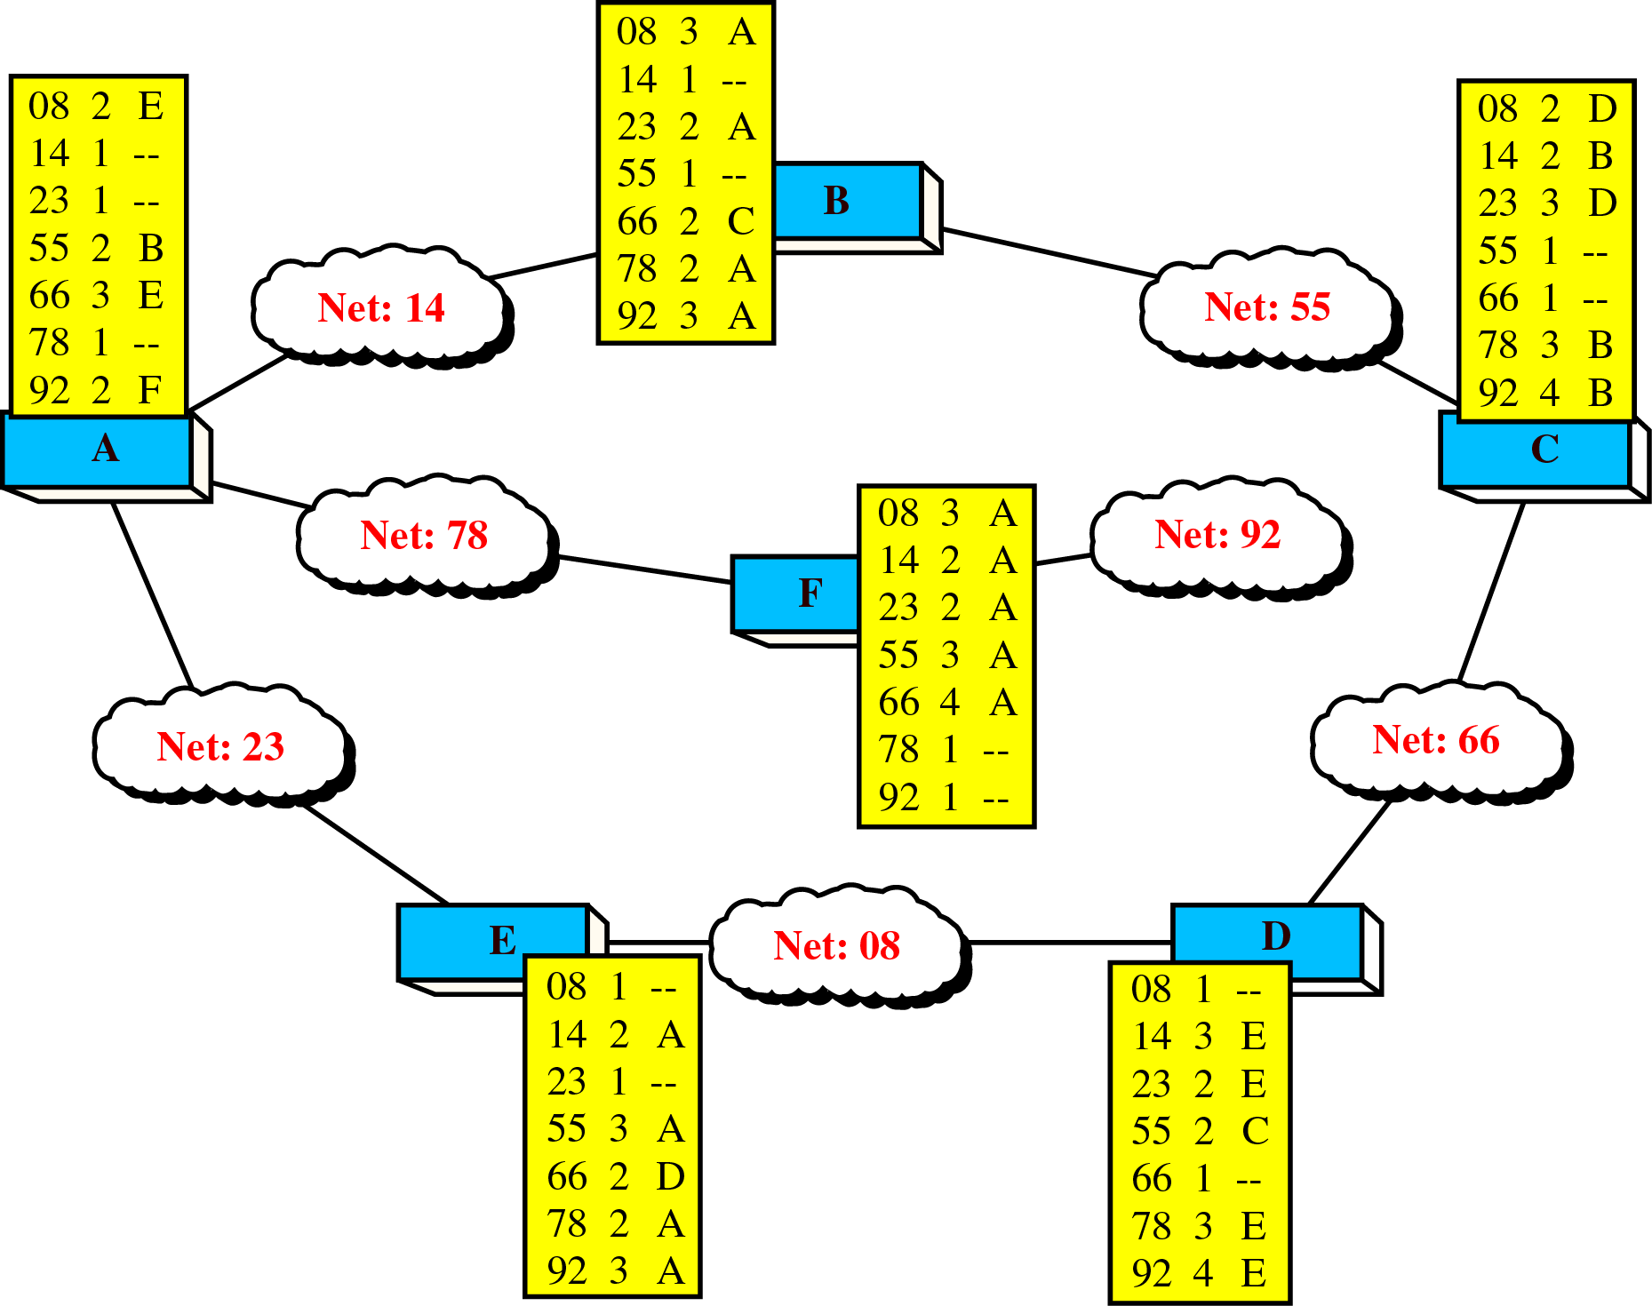

What is a Distributed Computing Platform?
A Distributed System is a Collection of SMALL independent computers that appears to its users as a single BIG coherent system.
Multiple Processes
Interprocess Communication
Disjoint Address Spaces
Collective Goal
Routing Algorithm : An Example

Slide 6
Transparency in Distributed Computing
Location Transparency
MyName
obref = lookup(“MyName”)
Naming Service
OtherName
ret = obref.method(“param”)
---
Lookup for MyName
Register with MyName
Client
Server
Create
Remote Object

Slide 7
Transparency in Distributed Computing
Failure Transparency
MyName
obref = lookup(“MyName”)
Naming Service
OtherName
ret = obref.method(“param”)
---
Lookup for MyName
Register with MyName
Client
Server
Create
Remote Object

Slide 8
Transparency in Distributed Systems
Failure Transparency
success = false
while(!success) {
try {
obref = lookup(“MyName”)
success = true
} catch(Exception e) {
delay(2000)
}
}
MyName
Naming Service
OtherName
ret = obref.method(“param”)
---
Lookup for MyName
Register with MyName
Client
Server
Create
Remote Object

Slide 9
Transparency in Distributed Systems
Relocation Transparency
success = false
while(!success) {
try {
obref = lookup(“MyName”)
success = true
} catch(Exception e) {
delay(2000)
}
}
MyName
Naming Service
OtherName
ret = obref.method(“param”)
---
Lookup for MyName
Register with MyName
Register with MyName
Client
Server 2
Server 1
Create
Remote Object

Slide 10
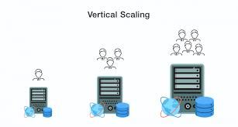
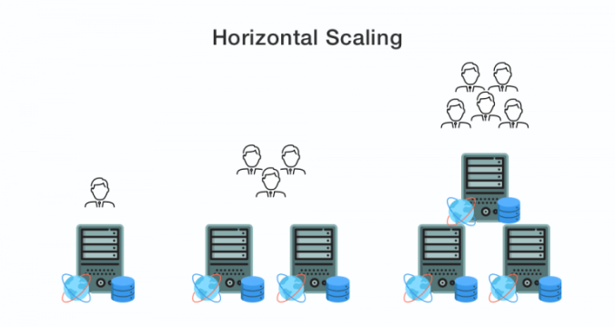
Scalability in Distributed Systems
A scalable distributed system can adapt to changes in demand by expanding its resources or redistributing tasks effectively.
Vertical Scalability (Scale-Up):
Increasing the capacity of existing nodes by adding more resources
Horizontal Scalability (Scale-Out):
Adding more nodes to the system to handle increased demand.

Slide 11
Scalability in Distributed Systems
(K₁,V₁)
K V
K V
K V
K V
K V
K V
K V
K V
K V
K V
K V
K V
K V
K V
K V
K V
K V
K V
K V
K V
K V
K V
K V
K V
K V
K V
K V
K V
K V
K V
K V
K V
Distributed Hash Table
insert(key, value)
value = lookup(key)
K V
insert(K₁,V₁)
lookup(K₁)
Scalable Hash Table : No. of hops to insert and lookup is independent of no. of nodes

Slide 12
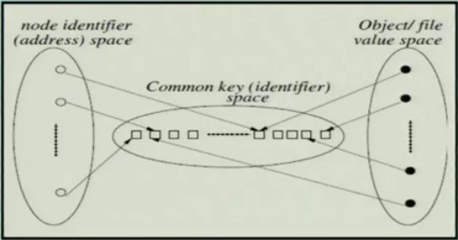
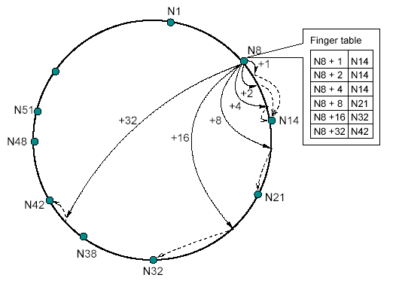
Scalability in Distributed Systems
Chord Distributed Hash Table
Finger table: finger[i] = successor (n + 2^{i} )
h(IP) → m-bit id
h(file name) → m-bit id
000
111
001
110
010
101
011
100

Slide 13
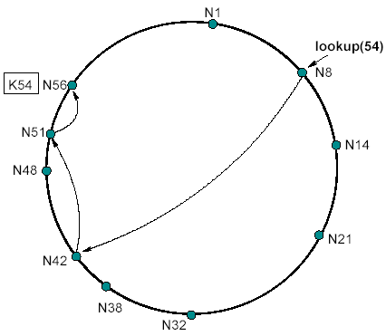
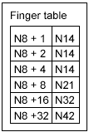
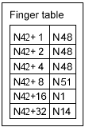
Scalability in Distributed Systems
Finger table: finger[i] = successor (n + 2^{i} )

Slide 14
Questions?
Thank You

